Slide 1
Changes in Population Size

Slide 2
Factors Influencing Population Size
Immigration (moving in)
Emigration (moving out)
Natality (birth)
Mortality (death)

Slide 3
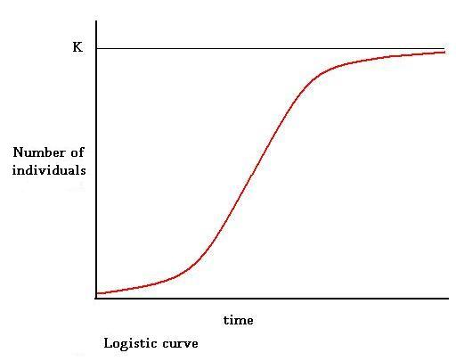
Changes in Population: Logistic Growth
Aka “S Shaped”
3 phases
Lag phase: small population, increasing slowly
Log phase: rapid growth
Resistance: growth slows, deaths increase

Slide 4
Logistic Growth
K = Carrying Capacity: the maximum number of individuals that be sustained by available resources
At “K”, dynamic equilibrium occurs: the number of births = number of deaths

Slide 5
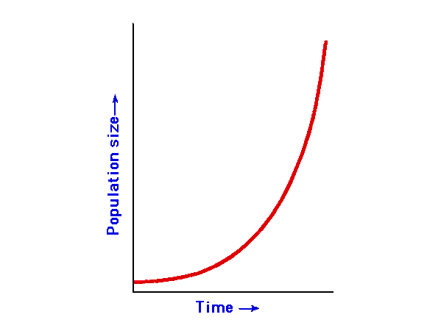
Exponential Growth
Aka “J shaped”
Smooth curve, continuous reproduction, rapid growth
Ideal conditions

Slide 6
Human Population Growth (UN data)
World population reached: | Year | Time to add 1 billion
1 billion | 1804
2 billion | 1927 | 123 years
3 billion | 1960 | 33 years
4 billion | 1974 | 14 years
5 billion | 1987 | 13 years
6 billion | 1999 | 12 years
Why did it take so long for the population to reach 1 billion?
Why did the doubling time accelerate so quickly after the first 1 billion was reached?

Slide 7
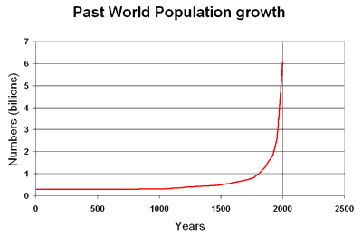
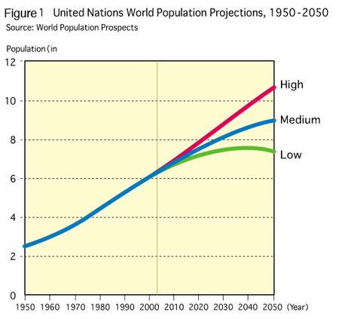
Human Population Growth
Additional source: http://www.worldometers.info/

Slide 8
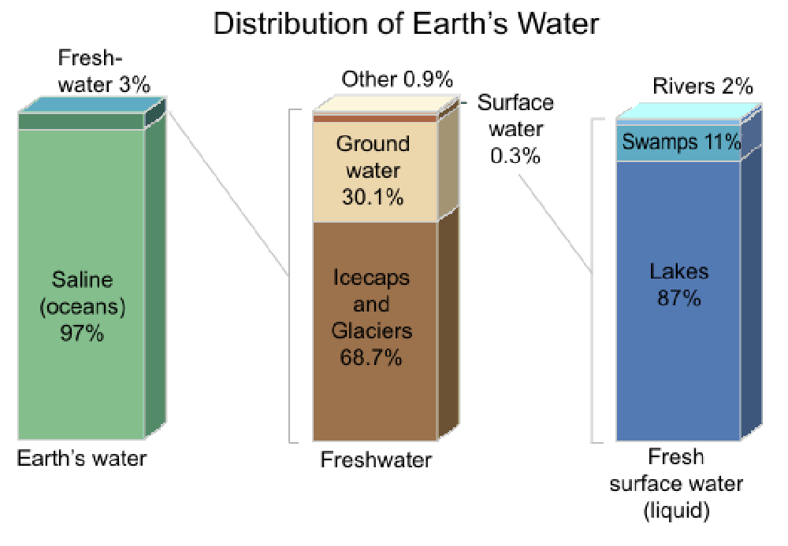
Human Overpopulation & Carrying Capacity of Available Resources: An Example

Slide 9
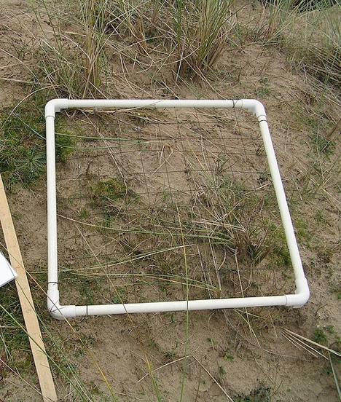
Estimating Population Sizes
Mark-Recapture: (from the intro activity). Used for estimating population sizes of moving organisms
Quadrats: a square used to sample slow or non-moving organisms. Good to get a representative measure (estimate) of population size, rather than counting all of the organisms

Slide 10
Growth Models & Life History
r-selected strategy: short life span, reproduce large amounts of offspring, little or no parental care
Insects, annual plans, and algae are examples of organisms that use r-selected strategies
They take advantage of favourable environmental conditions such as food, sunlight, warmer temperatures and they reproduce quickly. They experience exponential growth in the summer, but die quickly at the end of the season.

Slide 11
K-selected strategy: long life span, reproduce fewer offspring, more parental care, closer to the carrying capacity (K)

Slide 12
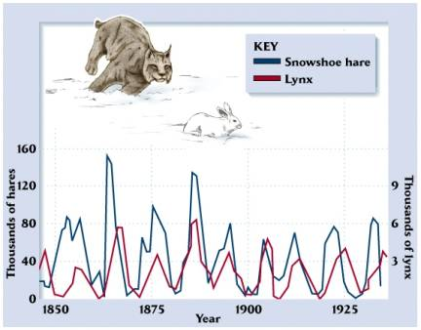
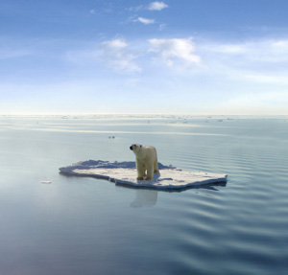
What Limits Growth of Populations?
Density Independent Factors – e.g. disasters, disease.
Density Dependent Factors – e.g. predator runs out of prey to eat, crowding of organisms (e.g. trees) leads to competition, etc.

